Slide 1

Lab 6

Slide 2
Lab Goal
Using spatial hashing to find the closest pair of points in a 2D plane
Although this can be done by comparing all points in the plane to one another, doing so will consist of a complexity O(n^2) which is too slow for input sizes that get very large

Slide 3
Code To Write
double closestPair(string filename)
This function is responsible for returning a number which is the distance between the two closest points in the given file
The function must first read through the file to retrieve all the points
The function must then calculate the proper distances between points and return the smallest distance calculated

Slide 4
Text File Formating
The first line contains the number of points that exist within the given plane
The file the contains N lines (where N is the number of points) which each represent a point in the plane
Each point is represented as two numbers separated by a single space
The first number is the x location of the point and the second number is the y location of the point
All given coordinates will be greater than or equal to 0 and less than 1
0 <= x,y < 1

Slide 5
How to Create the Plane
Read in the number of points from the input file
Based on the number of points come up with some value b where plane dimensions = bxb
b should properly scale with the number of points
Create some kind of representation of the plane using data structures of your choice
Place the points in the proper cell based on their x and y value

Slide 6
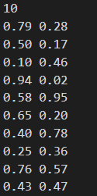
Plane creation example
Plane
Textfile
0
1
2
0
1
num_points = 10
b = 3
interval = 1/3 = .333
2
* You must come up with some way of calculating b based on the number of points

Slide 7
Plane creation example (cont.)
Plane
Textfile
0
1
2
 |  | (.79, .28)
0
1
inverval = .333
x = .79, y= .28
xpos = .79 /.333 = 2
ypos = .28 /.333 = 0
2
* When producing xpos and ypos you must round the values down to the nearest integer

Slide 8
Plane creation example (cont.)
Plane
Textfile
0
1
2
 | (.50, .17) | (.79, .28)
0
1
inverval = .333
x = .50, y= .17
xpos = .50 /.333 = 1
ypos = .17 /.333 = 0
2
* When producing xpos and ypos you must round the values down to the nearest integer

Slide 9
Plane creation example (cont.)
Plane
Textfile
0
1
2
 | (.50, .17) | (.79, .28)
(.10, .46)
0
1
inverval = .333
x = .10, y= .46
xpos = .10 /.333 = 0
ypos = .46 /.333 = 1
2
* When producing xpos and ypos you must round the values down to the nearest integer

Slide 10
Plane creation example (cont.)
Plane
Textfile
0
1
2
 | (.50, .17) | (.79, .28) (.94, .02)
(.10, .46)
0
1
inverval = .333
x = .94, y= .02
xpos = .94 /.333 = 2
ypos = .02 /.333 = 0
2
* When producing xpos and ypos you must round the values down to the nearest integer

Slide 11
Plane creation example (cont.)
Plane
Textfile
0
1
2
 | (.50, .17) (.65, .20) | (.79, .28) (.94, .02)
(.10, .46) (.25, .36) | (.43, .47) | (.76, .57)
 | (.58, .95) (.40, .78)
0
1
Continue same process until all points have been added to the plane
2

Slide 12
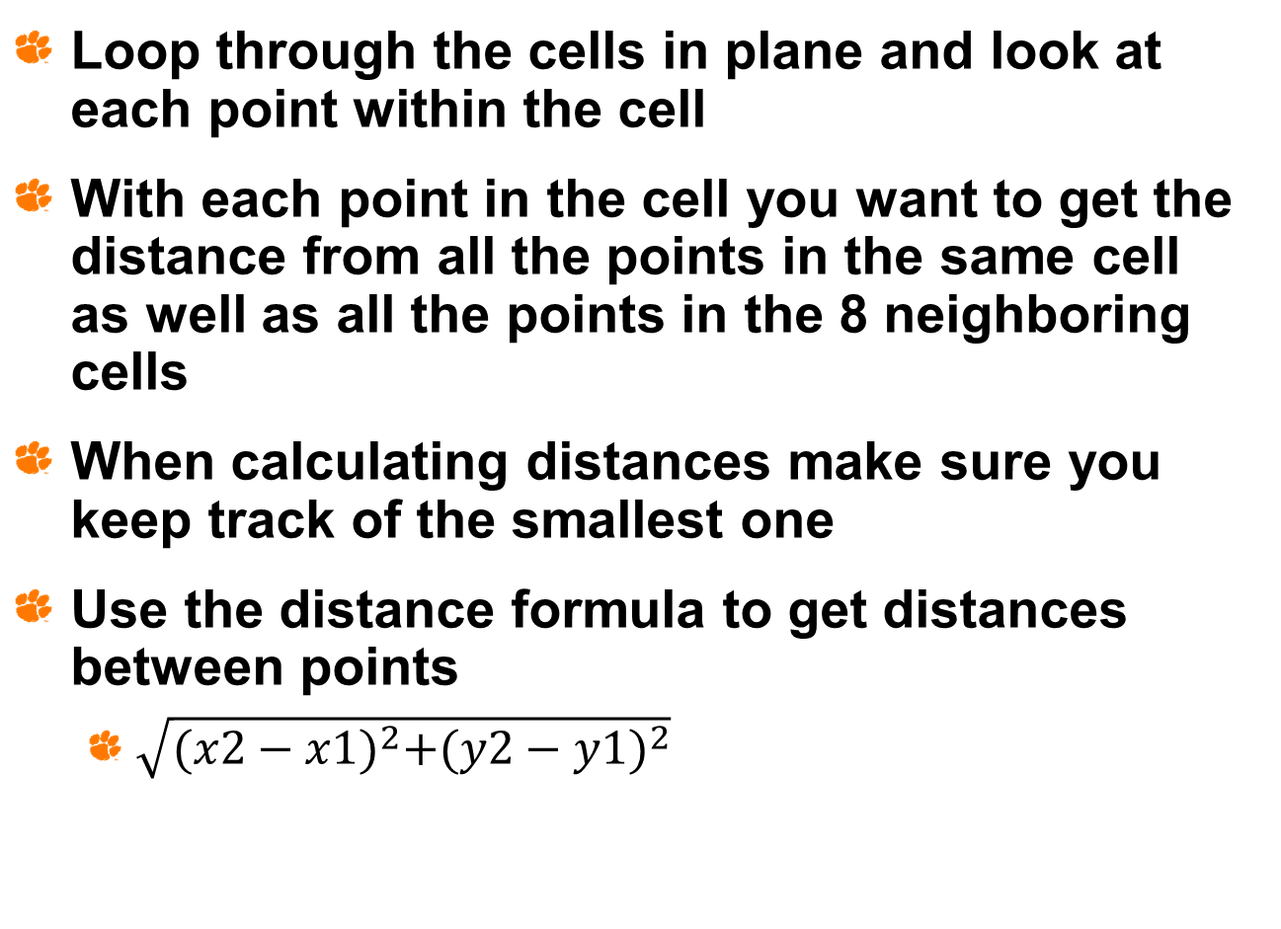
Calculating the Smallest Distance
Loop through the cells in plane and look at each point within the cell
With each point in the cell you want to get the distance from all the points in the same cell as well as all the points in the 8 neighboring cells
When calculating distances make sure you keep track of the smallest one
Use the distance formula to get distances between points
$\sqrt{{(x2−x1)}^{2}+{(y2−y1)}^{2}}$

Slide 13
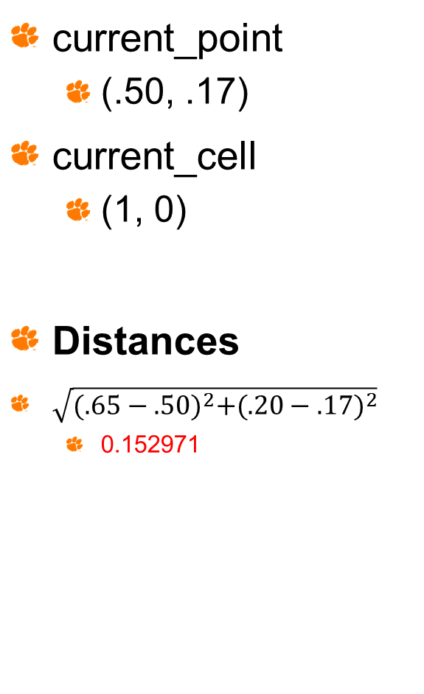
Smallest Distance Example
Plane
current_point
(.50, .17)
current_cell
(1, 0)
Distances
$\sqrt{{(.65−.50)}^{2}+{(.20−.17)}^{2}}$
0.152971
0
1
2
 | (.50, .17) (.65, .20) | (.79, .28) (.94, .02)
(.10, .46) (.25, .36) | (.43, .47) | (.76, .57)
 | (.58, .95) (.40, .78)
0
1
2
smallest_distance = 0.152971

Slide 14
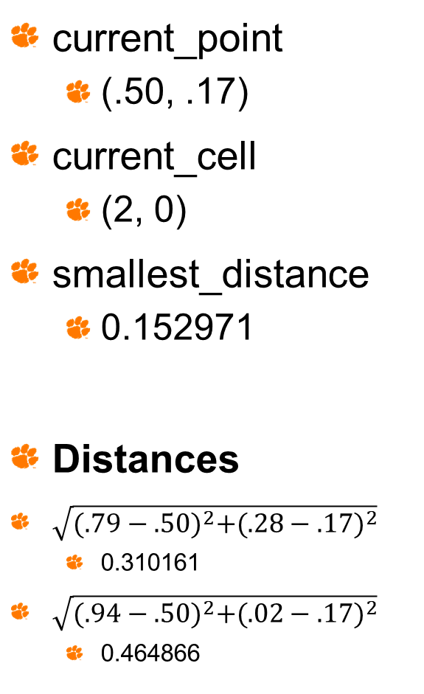
Smallest Distance Example (cont.)
Plane
current_point
(.50, .17)
current_cell
(2, 0)
smallest_distance
0.152971
Distances
$\sqrt{{(.79−.50)}^{2}+{(.28−.17)}^{2}}$
0.310161
$\sqrt{{(.94−.50)}^{2}+{(.02−.17)}^{2}}$
0.464866
0
1
2
 | (.50, .17) (.65, .20) | (.79, .28) (.94, .02)
(.10, .46) (.25, .36) | (.43, .47) | (.76, .57)
 | (.58, .95) (.40, .78)
0
1
2
smallest_distance = 0.152971

Slide 15

Smallest Distance Example (cont.)
Plane
current_point
(.50, .17)
current_cell
(0, 1)
smallest_distance
0.152971
Distances
$\sqrt{{(.10−.50)}^{2}+{(.46−.17)}^{2}}$
0.494065
$\sqrt{{(.25−.50)}^{2}+{(.36−.17)}^{2}}$
0.314006
0
1
2
 | (.50, .17) (.65, .20) | (.79, .28) (.94, .02)
(.10, .46) (.25, .36) | (.43, .47) | (.76, .57)
 | (.58, .95) (.40, .78)
0
1
2
smallest_distance = 0.152971

Slide 16
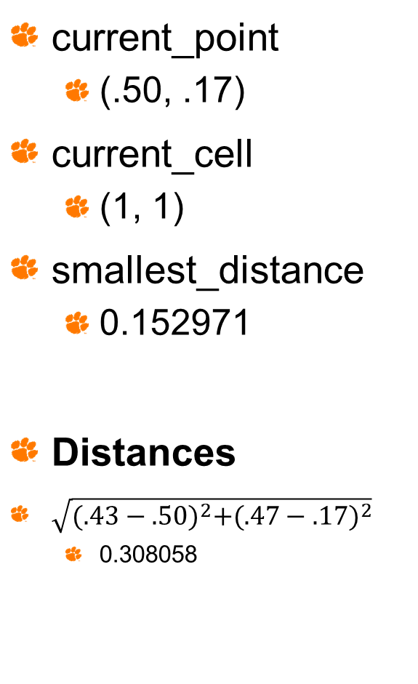
Smallest Distance Example (cont.)
Plane
current_point
(.50, .17)
current_cell
(1, 1)
smallest_distance
0.152971
Distances
$\sqrt{{(.43−.50)}^{2}+{(.47−.17)}^{2}}$
0.308058
0
1
2
 | (.50, .17) (.65, .20) | (.79, .28) (.94, .02)
(.10, .46) (.25, .36) | (.43, .47) | (.76, .57)
 | (.58, .95) (.40, .78)
0
1
2
smallest_distance = 0.152971

Slide 17

Smallest Distance Example (cont.)
Plane
current_point
(.50, .17)
current_cell
(2, 1)
smallest_distance
0.152971
Distances
$\sqrt{{(.76−.50)}^{2}+{(.57−.17)}^{2}}$
0.477074
0
1
2
 | (.50, .17) (.65, .20) | (.79, .28) (.94, .02)
(.10, .46) (.25, .36) | (.43, .47) | (.76, .57)
 | (.58, .95) (.40, .78)
0
1
2
smallest_distance = 0.152971
*Current point is done. Continue until all points have been searched

Slide 18
Some Hints
Remember that as you look at the neighbors of a point, some of those points have already calculated their distance in previous iterations, so try to come up with a technique that avoids doing the same calculation twice
The test cases will use various sets of points ranging from 10 points to 250,000 points in size

